Slide 1
Speaker: Group 15 Date：2020/4/22
Movie Recommender Systems
GUO Fusheng(19413238)
SU Zhanyi(19430051)
LEI Jinghao(19439954)

Slide 2




Introduction
What we want?
recommend
Top 10 Movie List
1.
2.
3.
4.
5.
6.
7.
8.
9.
10.
recommend
Find something interesting
based on the outputs.
recommend

Slide 3


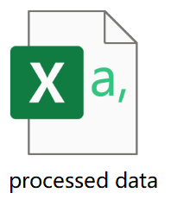

Data Acquisition & Processing
Where our data come from?
data processing
Web crawling
BeautifulSoup module
Random IP
Crawl data every 3 seconds
Delete:
27 missing values
1352 duplicate values
(2093 data)
Item-based & User-based CF
Content-based RS
https://www.imdb.com/chart/moviemeter/?ref_=nv_mv_mpm

Slide 4
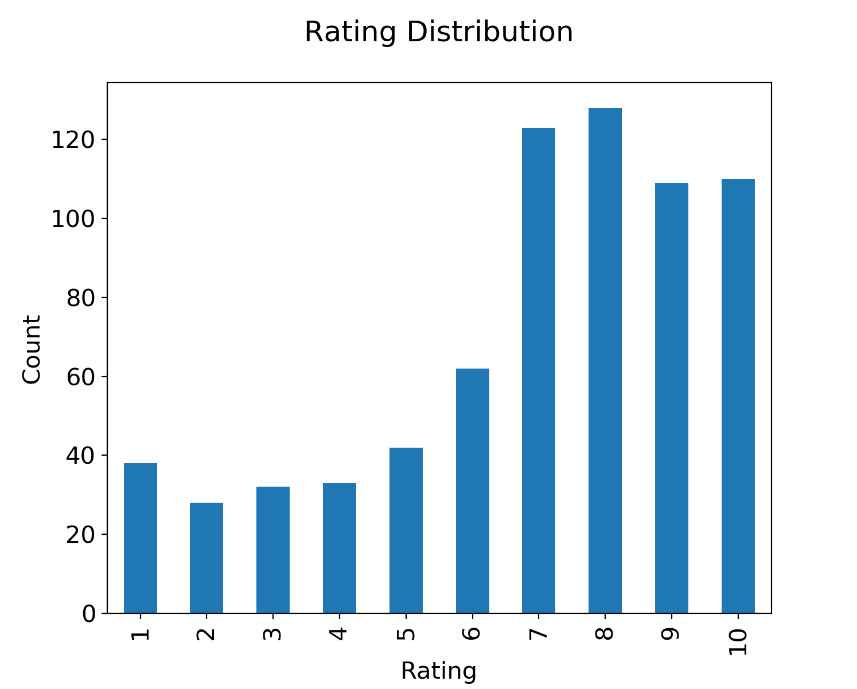
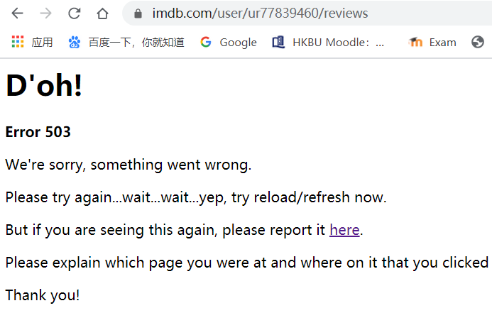
Data Acquisition & Processing
What our data look like?
705 rating records
555 movies
86 users

Slide 5
01
Content-based RS

Slide 6
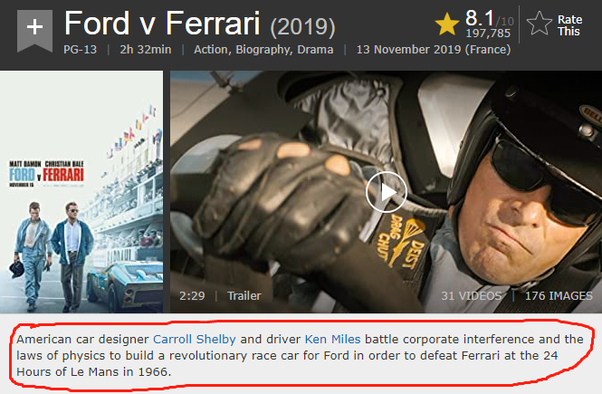
Data Pre-Processing
What data is needed for content-based?
Use rake_nltk
ford physics revolutionary race car 1966 american designer carroll shelby 24 hours driver ken miles battle corporate interference defeat ferrari laws build order le mans

Slide 7
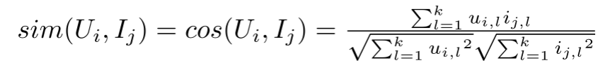
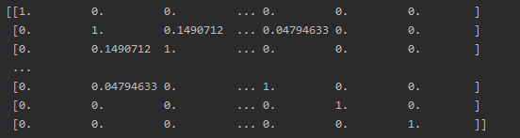
Content-based theory
CountVectorizer() from sklearn.feature_extraction
Movie 1 Movie 2 Movie 3 …..

Slide 8

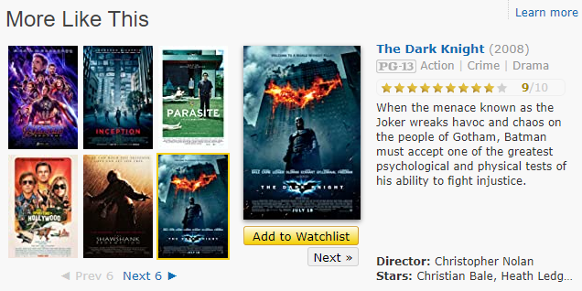
Compare
The result is satisfactory
although the data is limited

Slide 9
02
User-based/Item-based CF

Slide 10
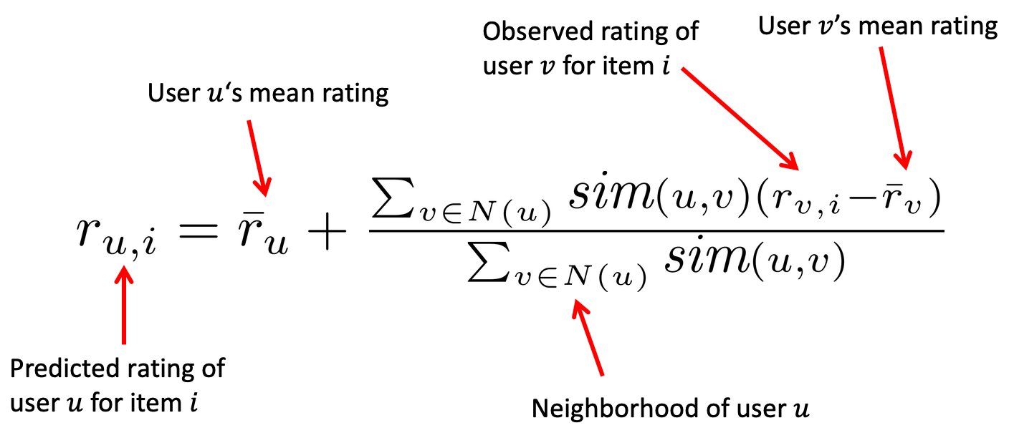
Principle of User-based/Item-based CF
Set default value 0 to address sparsity problem
For both algorithms, we provide Cosine and Pearson similarity for calculation

Slide 11
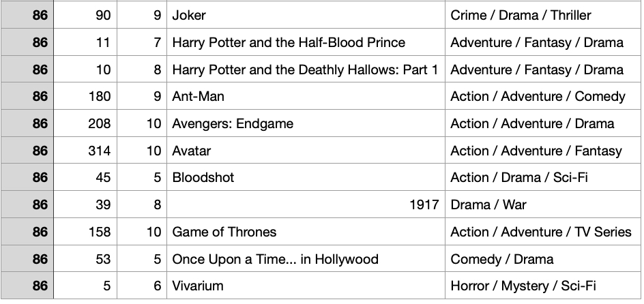
Comparison of User-based/Item-based CF
Set a user 86 who like to watch popular movie
Neighbor size = 20, using cosine similarity for calculation

Slide 12
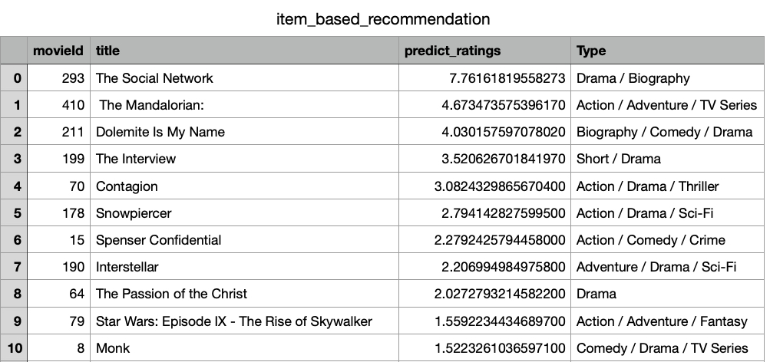
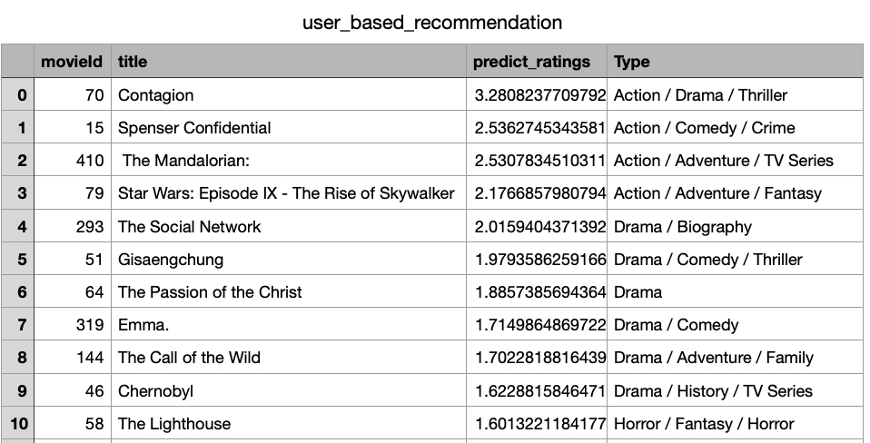
Comparison of User-based/Item-based CF
Item-based CF RS
User-based CF RS
Short movie and
Not popular
The recommendation list matches the demand of user 86
Limitation:
The data is not big enough to reach a higher accuracy
Only using default value 0 may punish some popular movies too hard

